Slide 1
Webinar: State Strategies to Reduce Child Poverty
Thursday, July 11, 2019

Slide 3
End Child Poverty
Campaign
To Cut Wisconsin’s Child Poverty Rate in in Half in Ten Years
Notes:
2 Faith Based Groups
2 Policy Groups

Slide 4
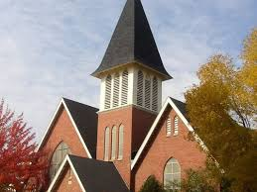
We hosted a path breaking 2 year conversation on poverty
24 major forums at churches & other religious settings
In every region of Wisconsin
Over 1,200 participants

Slide 5
We dug into the facts
who is poor
prevalence of poverty
racial inequality
causes of poverty
history of efforts to reduce poverty

Slide 6
% Poverty Over Time: 1959-2010 Children and Seniors
Sachs JD. The Price of Civilization. 2011, Random House, NY. Chapter 10, pp. 185-208
Notes:
It wasn’t always like this. A half century ago, the elderly were the social group with the highest rate of poverty (35% in 1959). Then came expansion of Social Security and introduction of Medicare, it plummeted to 25 in 1969, etc. The pattern for children was a different story. It dropped from 27 % to 14% in the 60s due to Medicaid and other social support, but began a gradual long-term climb so that now more than 1 in 5 children grows up in poverty. Government can work and we have made decisions as a society to support the elderly, but not to the same degree children. BTW, if we take these benefits away from seniors, their poverty level would increase 5-fold, back up to 1959 levels.
So when people say there is nothing we can do – this level of poverty is inevitable within a capitalist society – there are winners and losers – get used to it
I respond – look what we did for seniors. We made a choice. We could make the same choice for kids. We must make that choice – the future of our economy depends on it

Slide 7
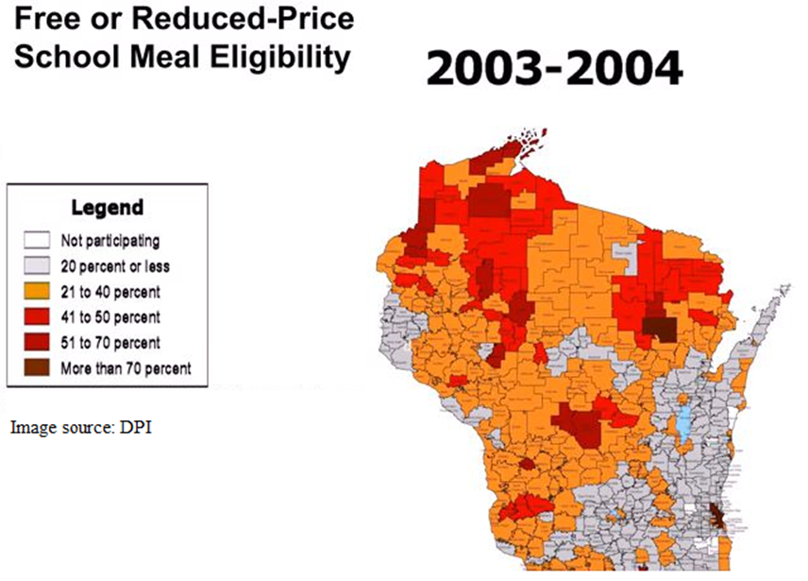
Notes:
We Found the poverty was increasing all over Wisconsin
We can see what this has meant for areas of our state by comparing maps of Wisconsin school districts that offer free or reduced-price school meals. The lighter areas have a lower percentage of students that are eligible for meals, the darker areas have a higher percentage, up to over 70%.

Slide 8
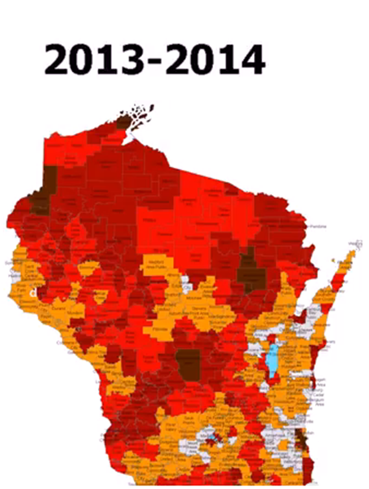
Notes:
We can see what this has meant for areas of our state by comparing maps of Wisconsin school districts that offer free or reduced-price school meals. The lighter areas have a lower percentage of students that are eligible for meals, the darker areas have a higher percentage, up to over 70%.

Slide 9
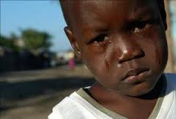
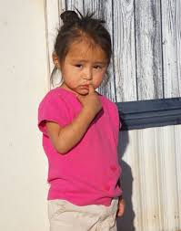
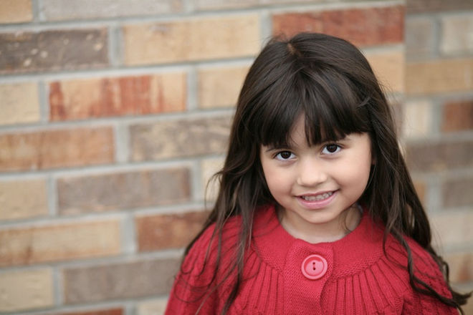
We found racial disparities are dramatic in Wisconsin
In WISCONSIN…
compared to white kids
African American kids are almost 5x more likely to be poor
Latino kids are 3x more likely to be poor
Native American kids are 4x more likely to be poor
….and the poverty rate for our African American kids is 8% above the national average for black child poverty
Notes:
Kids Forward – Race to Equity project

Slide 10
We reached agreement on causes
high rates of poverty are not primarily a result of individual moral failings
kids are clearly not responsible for their own plight
poverty is a result of human-made economic and social structures

Slide 11
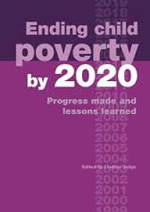
We were inspired by the promise of a goal oriented approach
Great Britain adopted the national goal of eliminating child poverty by the year 2020
evidence-based strategies were adopted to address the scale of the problem
a robust evaluation and tracking system was adopted to:
evaluate progress in real time
identify what is working
. . . and what is not
. . . and recommend policy shifts
Notes:
We know now that other countries have also been successful using this strategy – e.g. Canada
And we now have an increasingly robust effort at the national level in the US lead by First Focus and the Poverty a

Slide 12
What the British Experience Shows
26.1
22.5
18.9
12.3
10.6
2010
Notes:
Graph is from Fighting Childhood Poverty in the US and UK: an update 2010 Smeeding nad Waldfogel. Additional data is from Living standards, poverty and inequality in the UK: 2012, Institute for Fiscal Studies UK Commentary by Cribb, Joyce and Phillip Page 76.

Slide 13
the path forward
Make our goal of cutting child poverty and racial disparities in half prevalent . . . .
Build a larger and larger group of supporters beyond the faith community…
Seek commitment from elected leaders and other community leaders…
Use our goal to force a choice, for or against…
Create a context where leaders cannot posture as advocates for children while taking no meaningful action at the scale of the problem. . .
Create a context for moral clarity and moral choice…
Notes:
Now have 5000 signators to our campaign
Have county resolution passed adopting our goals

Slide 14
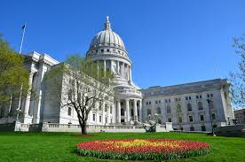
Legislative Goal
Establish Wisconsin government policy which officially adopts the goal of cutting child poverty and racial disparities in half in 10 years
put the goal in state statute
adopt initial evidenced based policies at the necessary scale
establish robust tracking and evaluation capacity to adjust policies and keep us on track

Slide 15
The obstacle is the will not the way
cutting child poverty in half is a moral imperative
we must extend a consensus around that imperative to larger and larger circles
…to the point where it becomes a shared goal for Wisconsin

Slide 16
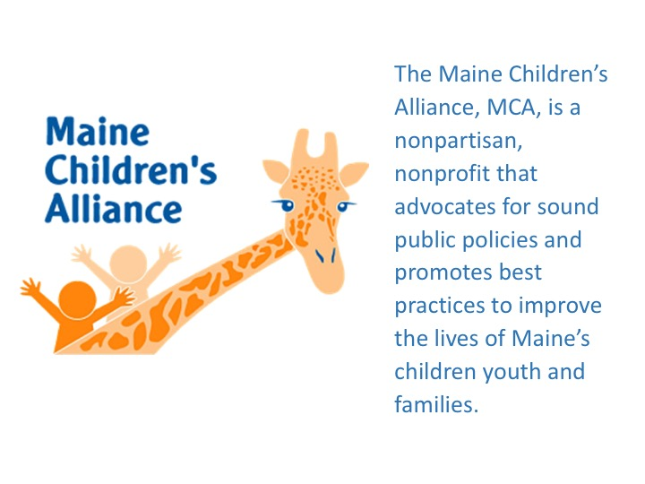

Slide 17
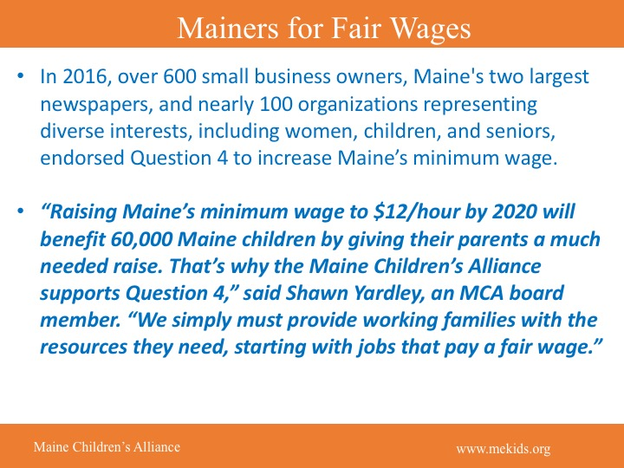

Slide 18
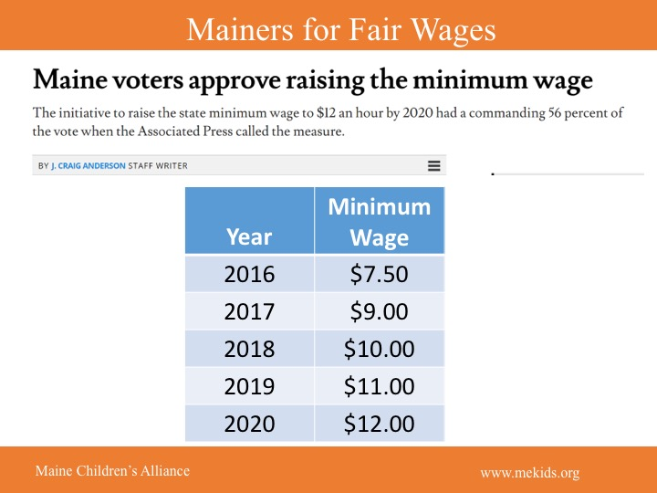

Slide 19
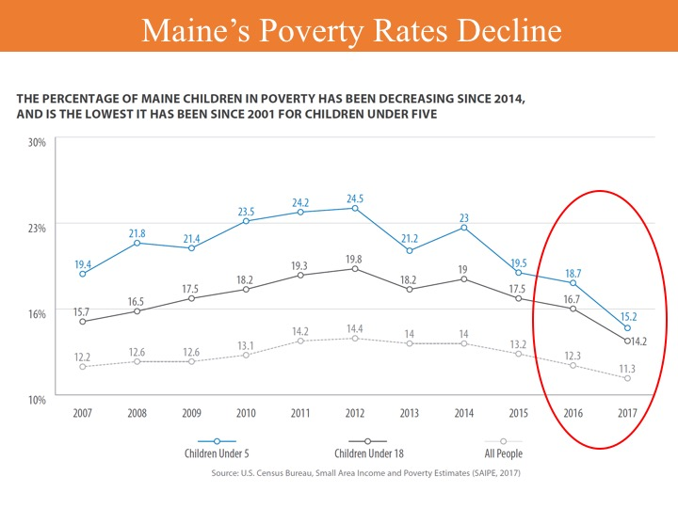

Slide 20
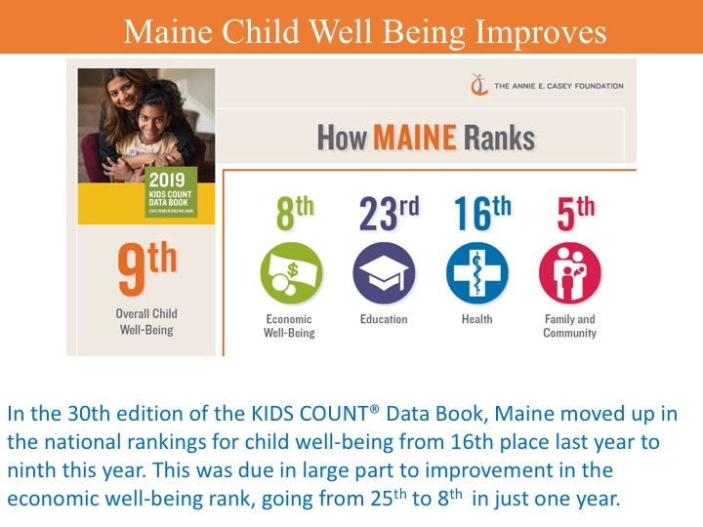

Slide 21
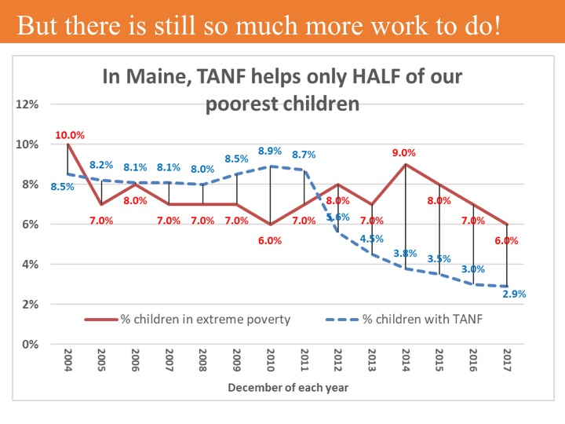

Slide 23
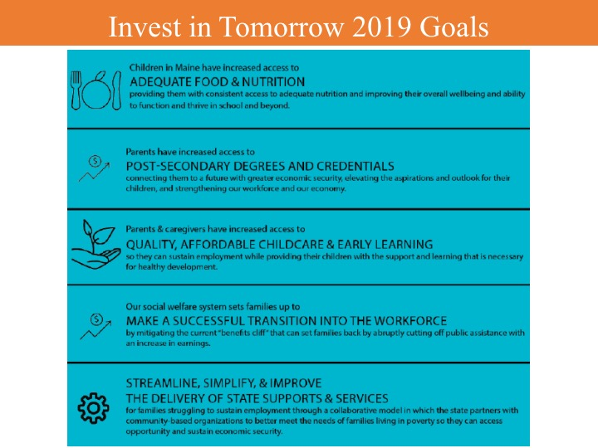

Slide 24
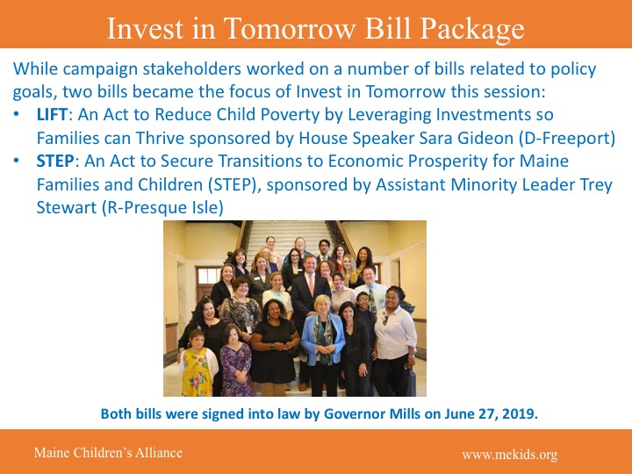

Slide 25
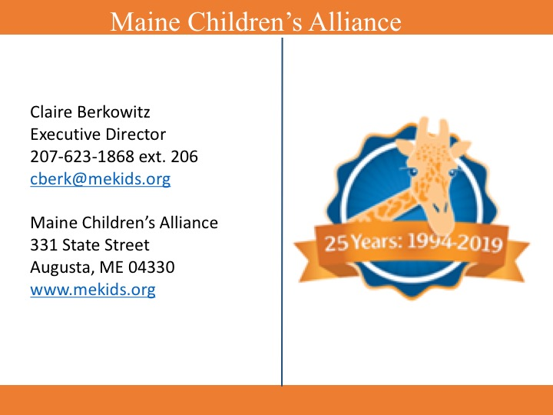

Slide 28
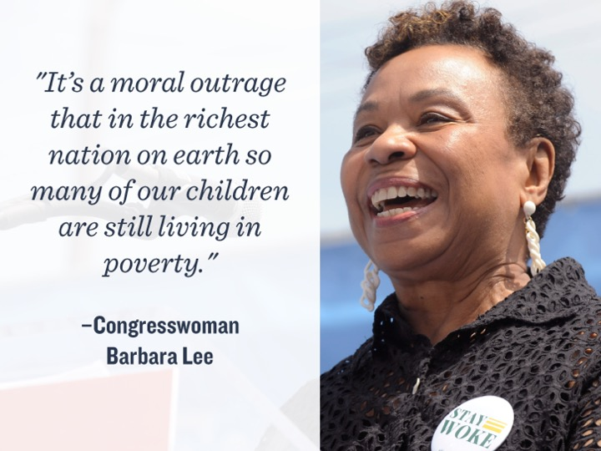

Slide 29
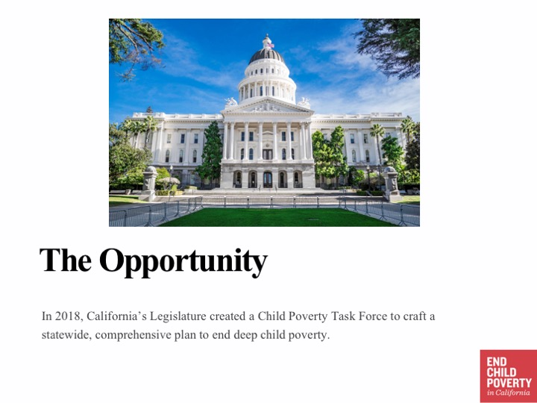

Slide 31
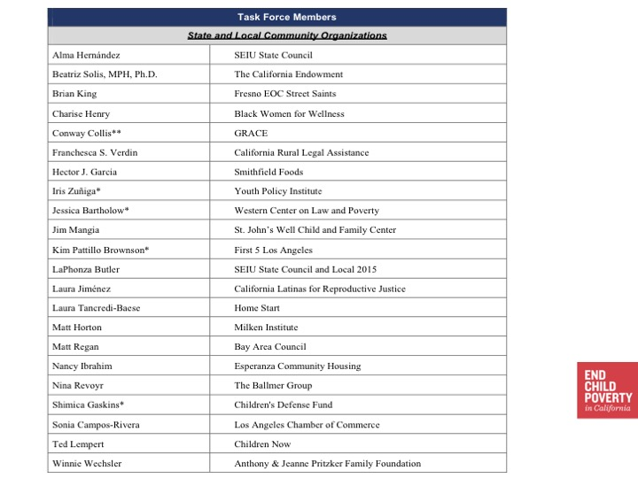

Slide 32
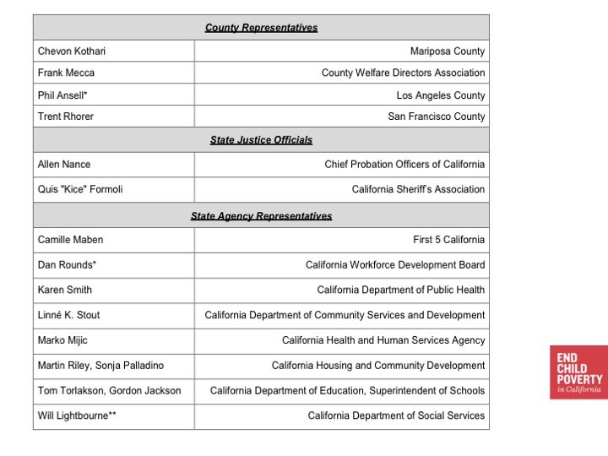

Slide 43
