Slide 1
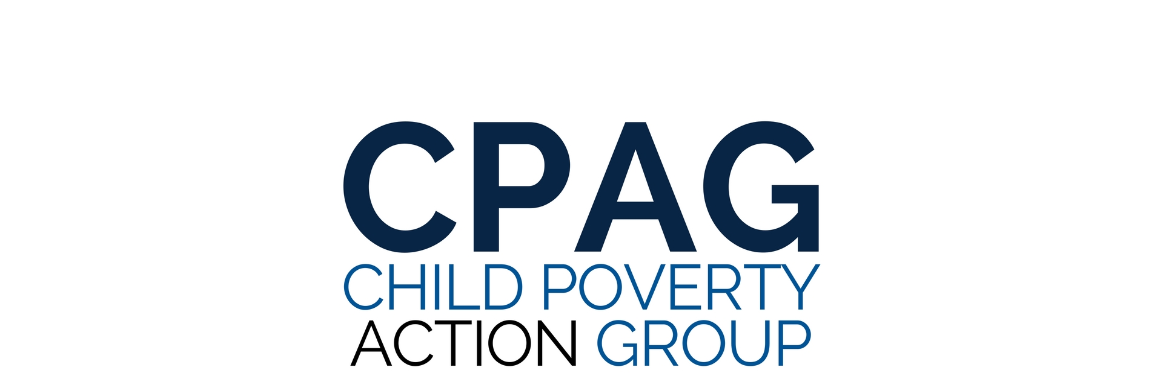

Our Kids, Our Future: Solutions to Child Poverty in the U.S.
Follow us: @CPAG_USA
www.childpovertyusa.org
April 12, 2018

Slide 2
CPAG MEMBERS
First Focus
UnidosUS
Save the Children Action Network
Center for Native American Youth
The Century Foundation
Sargent Shriver National Center on Poverty Law
PICO National Network
MomsRising
Child Welfare League of America
American Federation of Teachers
Prosperity Now
National Center for Children in Poverty
Partnership for America’s Children
National Latino Children’s Institute
Share our Strength
National Association of Counties (NACo)
Alliance for Strong Families and Communities
National Association for the Education of Young Children (NAEYC)
Catholic Charities USA
Center for the Study of Social Policy (CSSP)
National Black Child Development Institute (NBCDI)
The National Prevention Science Coalition to Improve Lives
Follow us: @CPAG_USA
www.childpovertyusa.org

Slide 3
Child Allowances
Andrew Stettner, Century Foundation, Bernard L. Schwartz Rediscovering Government Initiative, April 12, 2018

Slide 4

CASH - A little goes a long way
Rigorous Research (EITC, Eastern Cherokees, Food Stamps)
~$3,000 per year ->
  Decreased low birth weight
  Increased test scores
  Increased high school graduation
  Less alcohol, drugs
  Decreased crime
  Increased earnings in adulthood
Notes:
Thanks to Cara, Bruce and the staff at first focus for their incredible work on behalf of kids in poverty, Ben Ray Lujan
We know a lot more about the positive difference cash makes in the lives of children in poverty
Natural experiments like the increase in the EITC and the windfall of indian casino profits
Modest amounts of cash in childhood, especially the years under 6, have big long-term impacts.
Decrease in Low birth weight
Increased test scores
Increase in high school graduation
Less alcohol, drugs
Decreases in crime
Increased earnings in adulthood (as much as 20% increase in annual earnings)
Works in two ways
A result of the decrease in stress in poor households, that epidemiologists have shown disrupt kids all the way down to the cellular level
Families buy more of things kids need to develop: toys, books, etc.

Slide 5
THE BIG IDEA - UNIVERSAL CHILD ALLOWANCES
Modest Monthly ($250-300/Child)
Cash Payments to Families with Children
Notes:
Child Allowance:
Research into action
Available to all families but taxed back at higher levels ($75,000 family income). Regular bank transfer
Widely used across the industrial world
Featured component of UK’s and Canada’s campaigns to reduce child poverty
UK: $1,800 to $8,000 / year - key part of campaign to lift 800,000 kids out of poverty in 10 years.
Canada recently increases in child benefit to just under 5,000 $USD for kids under 6.
Broad ideological support.
Liberal poverty thinkers like Jane Waldfogel and Sandy Darrity to conservative thinkers like Sam Hammond at the Niskanen Center

Slide 6
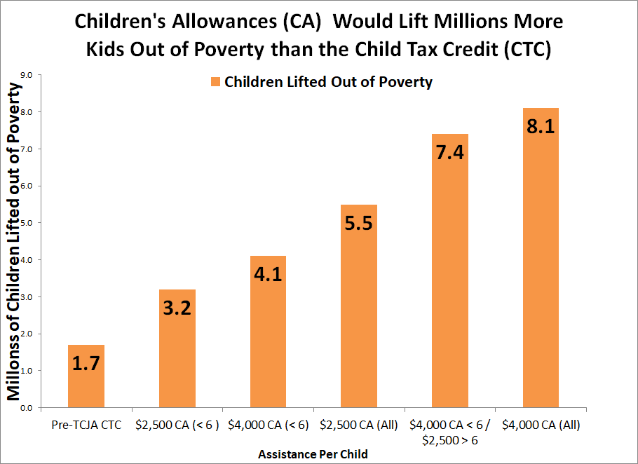
Source: Bernard L. Schwartz Rediscovering Government Initiative, TCF, 2016
Notes:
What about the child tax credit you might ask?
Our closest program, but does not have equal access to kids in poverty.
Only $1,400 of the $2,000 is refundable to those who don’t owe income tax
Phases in.
Workers need to earn $2,500 before getting any of the credit, and only get 15 cents for every dollar earned.
Thus a single mom with a two children needs to earn $30,000 to receive the full $2,000 per child credit.
Our research shows that even a modest child allowance approach would nearly double the anti-poverty impact of the current child tax credit.

Slide 7
Major Proposals
Tax Cuts and Jobs Act Enacted
  Expanded refundable CTC from $1,000 to $1,400 (non-refundable to $2,000)
Greenstein / Maag et all. Proposal (Published by Urban Institute)
  Make $2,000 CTC refundable with more generous phase in
American Family Act (S. 2018 Bennet/Brown) & Child Tax Credit Improvement Act (HR 821 DeLauro, Pelosi)
  Establish a young child tax credit of $300 per month ($3,600 per year)
  Over 6 $2,500 per year
  Fully refundable
  Paid monthly
  Follows major recommendations from poverty experts (Waldfogel, Smeeding, Schaeffer, et al.)
Notes:
Tax Cuts and Jobs Act did improve the child tax credit. Increase the refundable tax credit from $1,000 to $1,400, and lowered the earnings threshold from $3,000 to $2,500.
Delivered help to middle income and near poor working parents
27 million kids live in families without enough income to qualify for the full CTC
Eliminated access for children of immigrants
Earlier this month Bob Greenstein of the Center on Budget and Elaine Maag at the Tax Policy Center published a set of proposals.
The in between proposal would take the recently enacted increase in the CTC and make all of it refundable
TCJA was the first time these were decoupled
Would decrease the number excluded from the CTC by ⅔ and Lifts 400,000 more young kids out of poverty
American Family Act & Child Tax Credit Improvement aCt
Would transfrom the child tax credit act into a child allowance
Fully refundable credit to available to any child including those living in families with no current work income (phases out at $75/$110k)
Paid monthly as an advanced credit
Would cut post transfer child poverty in half from 16.1% to 8.9% and nearly eliminate extreme poverty (less than $2 day in cash)

Slide 8
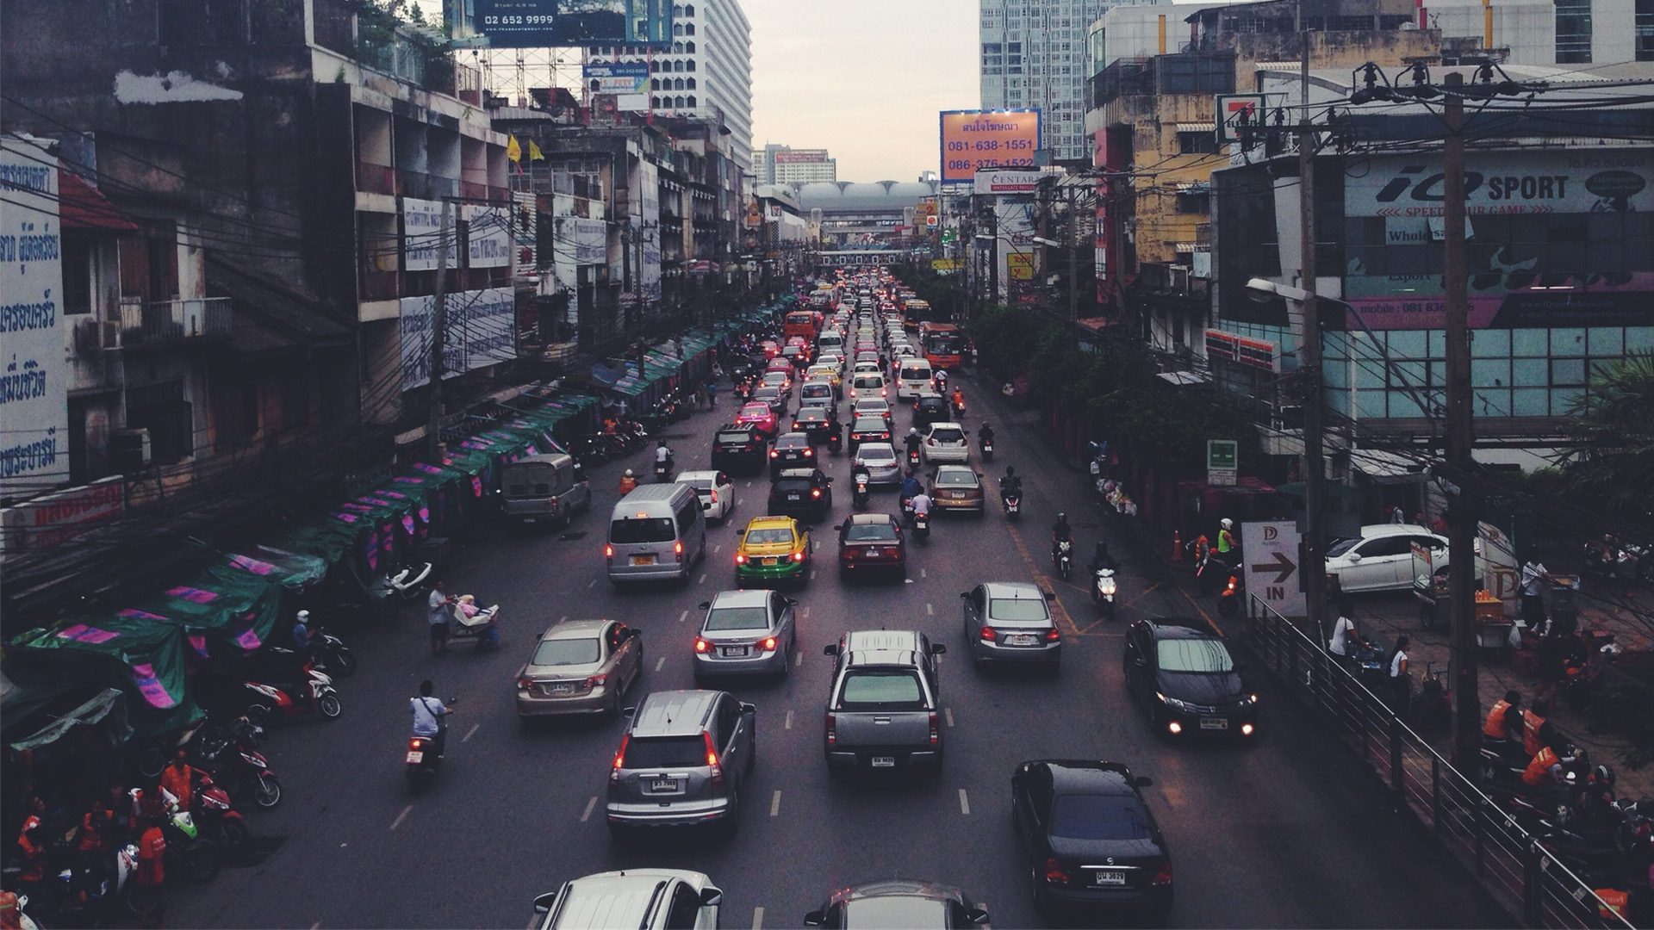


Creating the Political Will to Reduce Child Poverty in the U.S.

Slide 9
UK Policies to Meet the Target
Making work pay
Established national minimum wage
Developed targeted employment programs
Gave single parents given the right to request flexible working arrangements
Created new working Tax Credit, which provided subsidies to low-income workers (similar to our Earned Income Tax Credit)
Increase income for families
Reformed their child support system by disregarding all child support payments for eligibility for mean-tested benefits
Created a new child tax credit
Increased their universal child benefit, specifically for families with young children

Slide 10
UK Policies to Meet the Target
Investments in children
Increased paid maternity leave, doubled to nine months
Established two weeks of guaranteed paternity leave and
Implemented universal pre-k for 3 and 4 year olds
Introduced Sure Start, our equivalent of early Head Start, in the poorest areas for infants and toddlers.
Invested in K-12 education including increased funding and reduced class sizes

Slide 11
UK Child Poverty Act
Mandates UK government to:
Track progress based on several different measurements of poverty;
Develop a Child Poverty Strategy, as well as require the other nations of Scotland, Wales and Northern Ireland to develop strategies;
Establish an independent child poverty commission, to provide expertise and non-partisan advice in the development of this strategy;
Publish annual progress reports;
Collaborate with local governments and other stakeholders to reduce child poverty.

Slide 12
First Focus | www.firstfocus.org

Slide 13

Bringing a National Target to the U.S.
U
First Focus | www.firstfocus.org

Slide 14


Thank you!
Cara Baldari, Senior Policy Director, Family Economics
First Focus
carab@firstfocus.org
First Focus | www.firstfocus.org

Slide 15


A Universal Paid Family Leave Program
Suma Setty
Research Associate
Family Economic Security
National Center for Children in Poverty
Notes:
Good afternoon
Thank you for being here and to First Focus for creating this opportunity to discuss some big ideas today.
I’m Suma Setty and I’m a Research Associate at the National Center for Children in Poverty, NCCP.

Slide 16

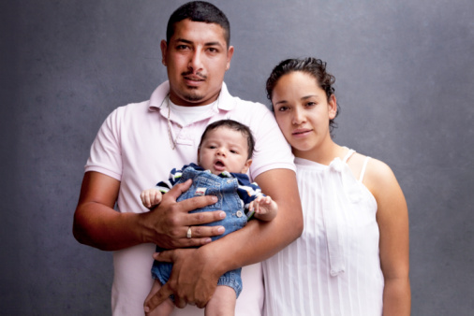

Putting research into action to improve lives
A non-partisan public policy research center dedicated to promoting healthy child development and strong, nurturing families that are economically secure. Our research helps decisionmakers craft effective policies in their cities and states as well as at the federal level.
Notes:
NCCP is a non-partisan public policy research center. We focus on 2 generation solutions for promoting the well-being of low-income families with children. My research in particular focuses on paid family leave policies in the U.S.

Slide 17

Types of Leaves
Medical leave
  To recover from one’s own illness or injury
Parental leave
  To bond with a new child
Family leave
  - Parental leave + caregiving leave
The federal Family and Medical Leave Act covers all of the above, providing 12 weeks of unpaid, job-protected leave in a year. 59 percent of all employees in the U.S. report meeting conditions to be eligible for FMLA protections.
Notes:
Before I dive in, I wanted to define our terms. Briefly, here are some of the terms that are thrown around when discussing paid and unpaid leaves from work.
Medical leave – refers to leave for recovering from one’s own serious illness, injury, or condition and pregnancy and childbirth-related conditions are included. This type of leave intersects with state temporary disability insurance and sick leave laws, among others.
Parental leave – to bond with a newborn or newly adopted child, and while it’s most commonly used to care for a newborn, the leave can for caring for a new foster or adopted child. Parental leave encompasses both maternity leave and paternity leave. Again, I’ll be focusing more on the first type of leave, parental leave, because of my background.
Family leave - encompasses leave for purposes covered under parental leave and as well as to care for a seriously ill family member.
In the U.S. the only federal protection we have regarding leave is the federal Family and Medical Leave Act. The FMLA provides 12 weeks of job-protected leave from work for all of these purposes. But it is unpaid and only about 59% report meeting the conditions for FMLA eligibility in the U.S.
For the purposes of this presentation, I’m going to focus mostly on medical leave related to pregnancy and childbirth and parental leave, because our work at the center is focused on families with children. I’m going to call it PFML for short.
---
To be eligible an employee must: (i) work for a firm with 50 employees within 75 miles of the employee’s worksite; (ii) have 12 months of tenure with this firm; and (iii) have 1,250 hours of service in the past year (about 24 hours per week). Only slightly more than half of all employees report meeting all three of these conditions to be eligible for the protections of the FMLA (59%). (Klerman, 2012). Molly will be addressing the intricacies of this policy later on.

Slide 18
Key takeaways
PFML can interrupt intergenerational poverty.
A well-designed PFML program must consider the needs of working, low-income families.
We have a large body of evidence to build a universal national leave program.
Notes:
PFML can interrupt intergenerational poverty.
But it can only do so if
A PFML program is designed with the needs of working, low-income families in mind.
We have a large body of evidence to build a universal national leave program. We don’t need to reinvent the wheel.

Slide 19
PFML is an income supplement during a time of transition, stress, and/or joy so working individuals can take time off work.
A well-designed paid medical and family leave program could alleviate child poverty.
Notes:
I’m going to talk about what constitutes a well-designed program, but first I want to talk about the current evidence that shows the pathway in which PFML programs has the potential to interrupt intergenerational poverty.
---
points to a number of positive impacts of paid family leave programs.
The next series of slides are pathways in which paid family leave works toward alleviating child poverty.

Slide 20
PFML enhances family economic security.
Well-designed program
Increased workforce attachment
Houser & Vartanian, 2012
More family income and greater economic security
Fewer children in poverty
Less dependence on public assistance
Houser & Vartanian, 2012
Higher wages for new moms
Bana, Bedard, Rossin-Slater, 2018
Notes:
Rigorous studies have shown that PFML enhances family economic security.
---
Paid family leave and child poverty are connected.
This and the next few graphics are drawn from rigorous quantitative studies.

Slide 21
Well-designed program
PFML improves health outcomes.
Longer breastfeeding duration Appelbaum & Milkman, 2011
Disadvantaged parents more likely to afford longer leaves
Bartel, Rossin-Slater, Ruhm, Stearns, & Waldfogel, 2015
Better health and cognitive outcomes
Higher likelihood of children being immunized
Berger, Hill, & Waldfogel, 2005
Higher likelihood of attending well-baby appointments Berger, Hill, & Waldfogel, 2005
Notes:
The evidence also shows that PFML improves health outcomes
---
Another pathway through which pfl and child well-being are connected

Slide 22
PFML improves educational and economic outcomes.
Well-designed program
Fathers more likely to take leave
Rossin-Slater, Ruhm, & Waldfogel, 2013
Better educational and economic outcomes for these children as adults
Better cognitive and behavioral outcomes
Huerta et al 2014
Fathers more likely to be involved in the child’s life later on
Pragg & Knoester, 2017
Notes:
And here’s yet another pathway through which pfl and child well-being are connected. And I haven’t even included evidence that points to the benefits of PFML to maternal health and businesses.

Slide 23
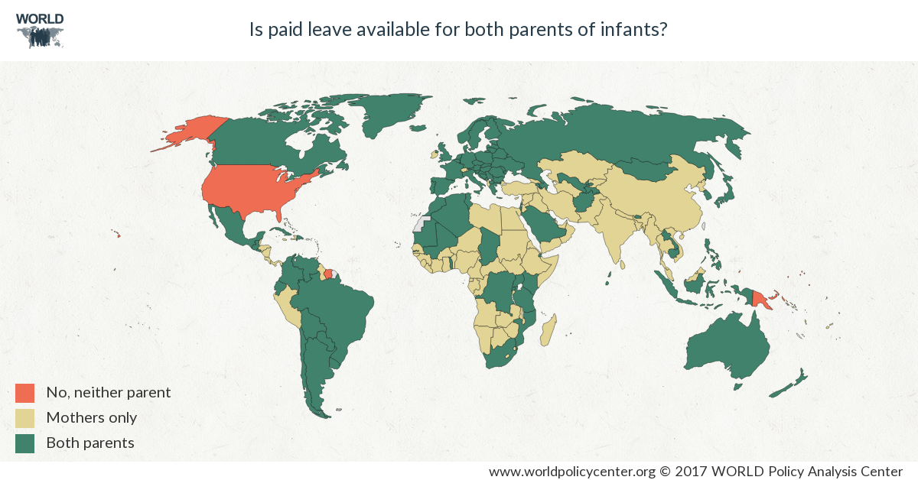
Is paid leave available for both parents?
Notes:
You already know this. The majority of the world has recognized the positive impacts of pfml, making the U.S. one of a handful of nations without a national paid leave program for either parent.
One good thing about this is that we can learn from these nations. There is a broad body of evidence that shows us what design elements are crucial in order for PFML to disrupt the cycle of poverty.
---
works in leave programs and what doesn’t.
---
As well as the positive impact of certain policy models for allowing workers to access paid leave during times of need.
From this map, it is clear that the rest of the world has acknowledged the numerous positive impacts of paid family leave on family economic security, the U.S. is the only OECD nation in the world without a national paid family leave program for either parent.
This map perfectly illustrates just how much of an outlier the U.S. when it comes to this issue. The U.S. joins the ranks of Suriname, Papua New Guinea, and 5 tiny pacific islands in offering its citizens/residents 0 weeks of paid leave after the birth of a child (other countries lacking paid leave are small pacific islands - Marshall Islands, Palau, Micronesia, Nauru, & Tonga). As you can see, the majority of Europe, where there are robust economies and low unemployment rates, offers paid leave to both spouses with a few exceptions (Ireland, Switzerland, Albania, Cyprus, and Turkey offer paid leave only to mothers).
Retrieved from: https://www.worldpolicycenter.org/policies/is-paid-leave-available-to-mothers-and-fathers-of-infants/is-paid-leave-available-for-mothers-of-infants
-----
Why are we so behind? Many theories in place, but I will get back to that if time permits. The point is that we are the only industrialized nation that does not offer some type of paid family leave.
---
Theory 1: This map is the perfect visual of American Exceptionalism. There is the pervasive sense that Americans are industrious individuals who do not need help from anyone to succeed. Additionally, unlike European nations, the U.S. does not have a strong labor rights movement. Change is happening because of the fact that women’s increased participation in the labor force is forcing more families to adapt and the environment to demand for a formal policy to allow parents to care for their children is growing because most families can’t afford to have one parent at home, not working.
http://theweek.com/articles/445827/how-america-ended-worst-maternity-leave-laws-earth
Theory 2: One historical explanation is that after WWII, Europe suffered massive infrastructure damage and casualties and the economies of Europe both needed more women to go back to work and also increase the birthrate (“replenish the population”). In post WWII United states, soldiers came home and women who worked in factories returned home, disincentivizing family-friendly workplace policies because of the presence of a caretaker at home. http://www.npr.org/sections/itsallpolitics/2015/07/15/422957640/lots-of-other-countries-mandate-paid-leave-why-not-the-us
Theory 3: Business lobby. Realted to the idea of American exceptionalism in that businesses should be able to figure out how to institute paid leave polices (Kurtzleben,
2015).
The inclusion of caregiving leave was included as high priority due to AARP efforts.
We do have, however, unpaid leave protections through the Family and Medical Leave Act
Citations: Pew Research Center. (2016). Of 41 nations, only U.S. lacks paid parental leave. Retrieved from http://www.pewresearch.org/ft_16-09-19_parental_leave/.

Slide 24
What is a well-designed paid leave policy?
Job-protected
Provides sufficient wage replacement
Encourages both spouses to take leave
Offers reasonable leave time
Easily understandable
Efficiently administered
Notes:
From the evidence, in order for PFL to work through the pathways to mitigate child poverty, a PFML program should ideally have these elements.
---
The first two, job-protection and sufficient wage replacement are important to making paid family leave programs accessible to low-income families. They need to be able to return to their jobs after they take leave, and they need to make ends meet, especially important for families that live paycheck to paycheck.

Slide 25
Policy options
Policy option | Strengths | Weaknesses
Federal mandate | Near-universal coverage | High cost to businesses, disproportionately impacting small businesses
Tax incentive | Businesses wouldn’t shoulder 100 percent of employee's wages on leave | Still funded by employers Does not incentivize employers with less initial capital to provide leave
Savings accounts | Less federal administrative oversight needed | May not be realistic option for low-wage workers
Early withdrawal of social security | Makes use of existing infrastructure and funds | Child bearing population may be too young to qualify High potential for reducing solvency of ss fund Requires investment.
National insurance program | Makes use of existing infrastructure Applies to a wider set of people | Requires investment
Notes:
Tie this back to slide 10.
Here are a couple of policy models that can all have those essential design elements I discussed in the prior slide, but they vary in how accessible they are to low-income families.
Variations of these models have been applied around the world as well as in the states.
There are many models the U.S. can adapt to implement paid leave. This is not an exhaustive list of policy options nor does it go through the all strengths and weaknesses of each design in detail, but this is a brief overview.
Federal mandate – requires employers to provide compensation to employees who need to take medical or family leave.
Tax incentive – a policy already exists. It was a part of the tax reform bill that was passed. It basically allows businesses that already offer paid leave to their employees a rebate for the wages they provide to low-income workers.
Savings accounts – these would work similar to 401(k)s in that employees would have the option to put a portion of their paycheck into a tax exempt account. Would benefit higher income workers because they could set aside more money for this leave, also low-income workers typically underutilize these types of savings accounts.
Early withdrawal of social security retirement benefits – this involves a clever use of existing funds and infrastructure. This model would allow workers to take retirement benefits early for, say, 6 weeks,
National insurance program – also could make use of existing infrastructure to administer benefits, but this would create a new fund through payroll taxes, like ss.

Slide 26
Other considerations
Addressing the issues of the ‘sandwich generation’
Including an expansive definition of family
Notes:
These considerations aren’t in the compendium, but they are equally important to discuss because they involve designing a paid family leave program that works well for more than just parents. There are more and more people falling into what’s being termed as the sandwich generation, which involves people who are caring for young children while simultaneously caring for elderly parents. Over 47% of middle aged adults fall into this category (Pew Research Centers).
We also need to consider a wider definition of family to accommodate all types of families, like siblings, grandparents, and to include caregivers who aren’t necessarily related to the person receiving care, like a neighbor or friend. This is very important to LGBTQ families who often talk about and care for their ‘chosen family’. We need to be inclusive in the ways in which we talk about paid family leave to allow for family types that aren’t necessarily evident on your tax return.

Slide 27
References
Appelbaum, E., & Milkman, R. (2011). Leaves that pay: Employer and worker experiences with Paid Family Leave in California. Washington, DC: Center for Economic and Policy Research.
Bana, S., Bedard, K., & Rossin-Slater, M. (2018). The impacts of paid family leave benefits: Regression kind evidence from California administrative data. NBER Working Paper No. 24438. Cambridge, MA: National Bureau of Economic Research. Retrieved from http://www.nber.org/papers/w24438.
Bartel, A., Rossin-Slater, M., Ruhm, C., Stearns, J. & Waldfogel, J. (2015). Paid family leave, fathers’ leave-taking, and leave-sharing in dual-earner households. NBER Working Paper. Cambridge, MA: National Bureau of Economic Research.
Berger, L. M., Hill, J. & Waldfogel, J. (2005). Maternity leave, early maternal employment and child health and development in the U.S. The Economic Journal, 115, F29-F47.
Houser, L. & Vartanian T.P. (2012). Pay matters: The positive economic impacts of paid family leave for families, businesses and the public. New Brunswick, NJ: Center for Women and Work, Rutgers University.
Huerta, M., Adema, W., Baxter, J., Han, W.J., Lausten, M., Lee, R., & Waldfogel, J. (2014). Fathers’ leave, fathers’ involvement and child development: Are they related? Evidence from four OECD countries. OECD Social, Employment and Migration Working Papers, No. 140, OECD Publishing. Retrieved from http://dx.doi.org/10.1787/5k4dlw9w6czq-en.
Pragg, B. & Knoester, C. (2017). Parental leave use among disadvantaged fathers. Journal of Family Issues, 38(8): 1157-1185. Retrieved from http://journals.sagepub.com/doi/pdf/10.1177/0192513X15623585.
Rossin-Slater, M., Ruhm, C., & Waldfogel, J. (2013). The effects of California’s Paid Family Leave program on mothers’ leave-taking and subsequent labor market outcomes. Journal of Policy Analysis and Management, 32(2), 224-245.

Slide 28
Additional Resources
Key Characteristics of parent leave systems (2017). OECD Social Policy Division, Directorate of Employment, Labour and Social Affairs. Retrieved from https://www.oecd.org/els/soc/PF2_1_Parental_leave_systems.pdf .
Paid family and medical leave. (2017). AEI-Brookings Working Group on Paid Family Leave. Retrieved from https://www.brookings.edu/wp-content/uploads/2017/06/es_20170606_paidfamilyleave.pdf .
Paid Parental Leave in the United States. (2014). Institute for Women’s Policy Research, funded by the U.S. Department of Labor Women’s Bureau. Retrieved from https://www.dol.gov/wb/resources/paid_parental_leave_in_the_united_states.pdf .
A Better Balance. Comparative Chart of Paid Family and Medical Leave Laws in the United States. Retrieved from http://www.abetterbalance.org/resources/paid-family-leave-laws-chart/
World Policy Analysis Center, “Is Paid Leave Available for Mothers and Fathers of Infants?,” September 2016, https://www.worldpolicycenter.org/policies/is-paid-leaveavailable-to-mothers-and-fathers-of-infants/is-paid-leaveavailable-for-mothers-of-infants.
Laura Addari, Naomi Cassirer, and Katherine Gilchrist, Maternity and Paternity at Work: Law and Practice across the World (Geneva: International Labour Organization, 2004), http://www.ilo.org/wcmsp5/groups/public/---dgreports/---dcomm/---publ/documents/publication/wcms_242615.pdf.
Notes:
There are a lot of resources out there to help people understand these programs better. We’ve copied some links here for reference if you’d like to visit these websites after this presentation.

Slide 29

Contact
NCCP
Website: http://nccp.org/
Twitter: @NCCP
Facebook: facebook.com/nccp.org
Suma Setty
ss4358@cumc.columbia.edu
Twitter: @sumasetty
Notes:
A well-designed paid family leave that reaches low-income workers can mitigate generational poverty and constitutes part of a larger vision for enhancing child well-being.
That, I think, is worth the investment.
A paid leave program that considers the needs of low-income families with children will be able to give people the opportunity to be better family members, friends, and workers and give the next generation a more solid foundation to succeed.
When children have their parents with them at the most vulnerable times in their lives, they have a better chance of developing into healthy humans with more economic opportunities.
Please feel free to email me with questions you have that we don’t get to address today.

Slide 30


COMBATTING EARLY CHILDHOOD POVERTY:
The role of counties in early childhood development
Eryn Hurley, Associate Legislative Director, NACo
April 2018

Slide 31
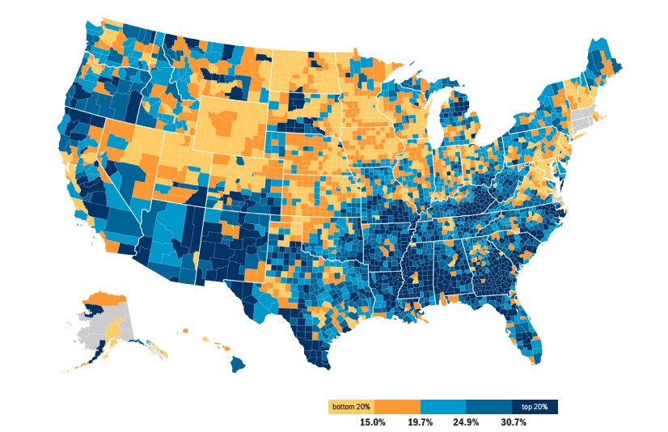
The Role of Counties in Early Childhood Development
2015 poverty: child poverty rate by county
In 2015, the majority of counties (54 percent) had poverty rates for school-age children ranging between 20.4 and 58.1 percent
Source: NACo analysis of U.S. Census Bureau, American Community Survey 2011-2015

Slide 32
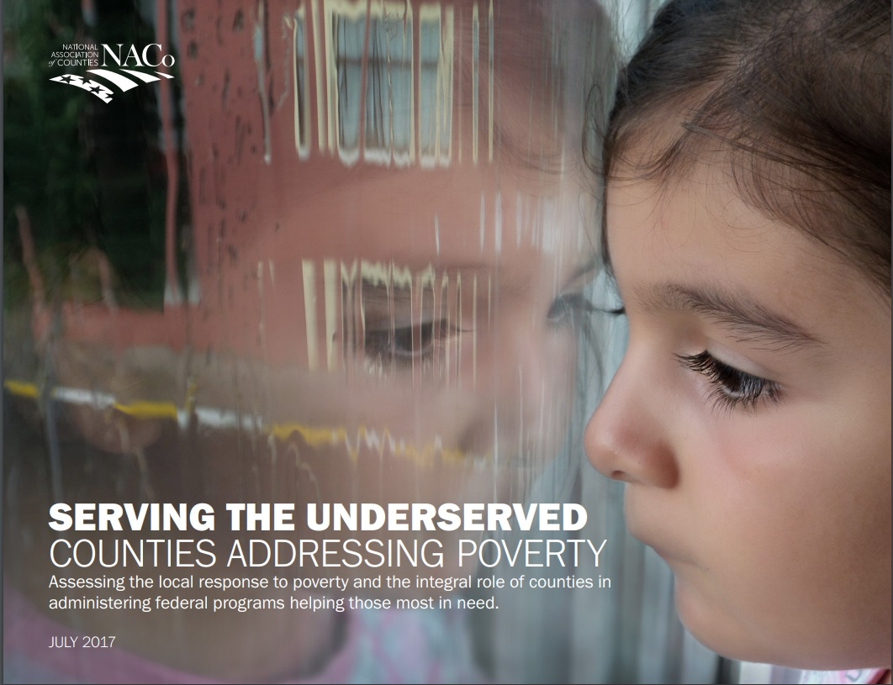
The Role of Counties in Early Childhood Development
Serving the underserved: counties addressing poverty

Slide 33

The Role of Counties in Early Childhood Development
Counties Care: county service sharing for early childhood development

Slide 34
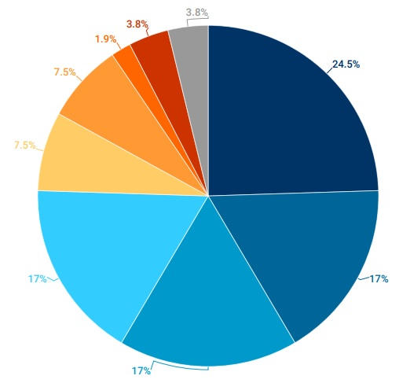
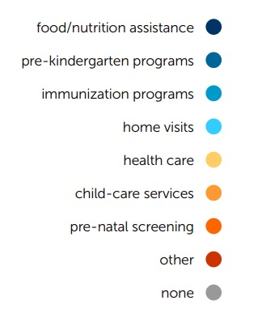
The Role of Counties in Early Childhood Development
Most prevalent types of ECD programs administered by counties
Source: NACo poll of states associations of counties, August 2017

Slide 35
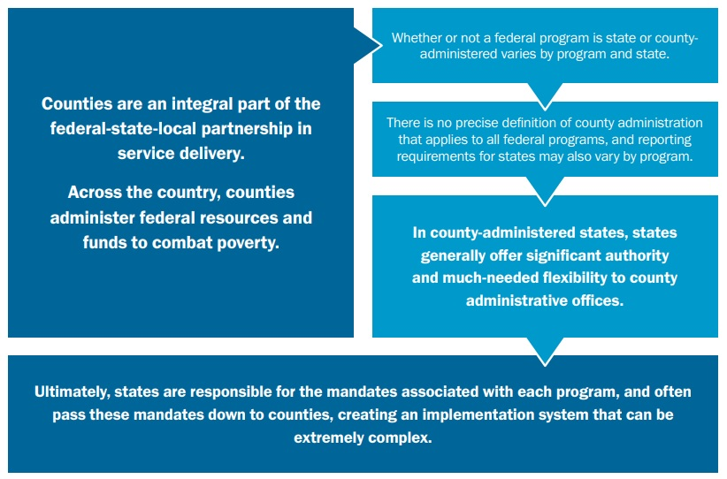
The Role of Counties in Early Childhood Development
State vs. county administration of programs
2013-2015 Federal Funding for ECD
Total ECD Federal Funding

Slide 36
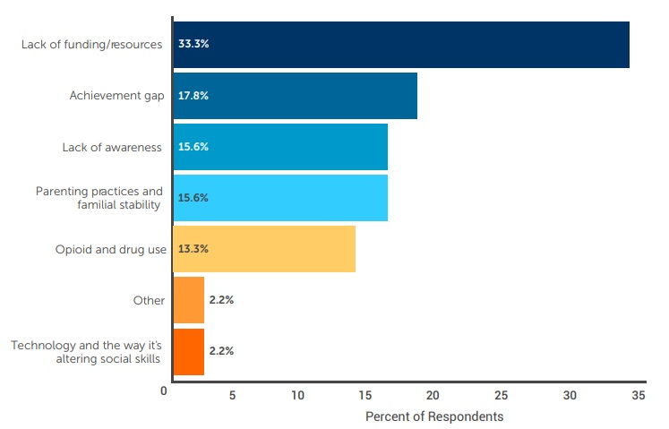
The Role of Counties in Early Childhood Development
Major challenges for ECD services
Source: NACo poll of states associations of counties, August 2017

Slide 37
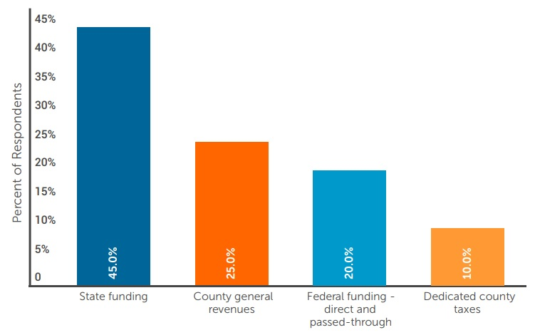
The Role of Counties in Early Childhood Development
Funding sources for ECD services
Between 2013 and 2015, more than 1,500 counties invested over $129 billion of federal funding in services that affect young children and their families.
Source: NACo poll of states associations of counties, August 2017

Slide 38
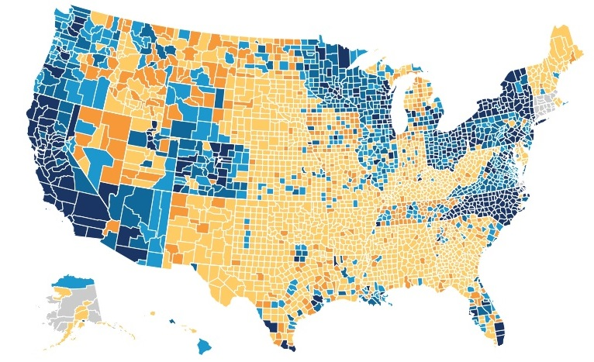

The Role of Counties in Early Childhood Development
Federal ECD funding for counties
2013-2015 Federal Funding for ECD
Total ECD Federal Funding
Source: NACo analysis of Federal Audit Clearinghouse Data, 2013-2015

Slide 39
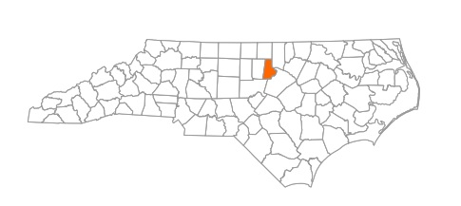
The Role of Counties in Early Childhood Development
Durham County, N.C.: Durham Connects
Other Entities Involved: Center for Child and Family Health,
Duke University’s Center for the Child and Family Policy
2016 Population Level: 306.2k
2016 Unemployment Rate: 4.5%
2016 Average Real Wages, in 2009 Dollars: $65,182
2015 Child Poverty Rate: 26.0%

Slide 40
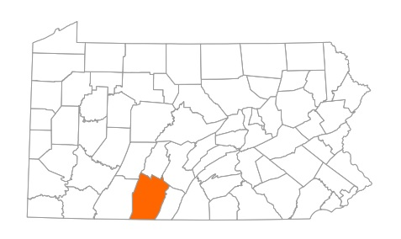
The Role of Counties in Early Childhood Development
Bedford County, Pa.: Bedford County Unified Family Services System
Other Entities Involved: Five independent school districts,
one independent public charter school, various businesses
and nonprofits in the community, various Pennsylvania
state departments
2016 Population Level: 48.3k
2016 Unemployment Rate: 5.8%
2016 Average Real Wages, in 2009 Dollars: $36,808
2015 Child Poverty Rate: 19.0%

Slide 41
THANK YOU!
Eryn Hurley, Associate Legislative Director, NACo
ehurley@naco.org | 202.942.4204
April 2018

Slide 42
Our Kids, Our Future: Solutions to Child Poverty in the U.S.
Follow us: @CPAG_USA
www.childpovertyusa.org
April 12, 2018

